Slide 1

WhatsApp
Simple. Reliable. Private
With
Buying Stocks And Mutual Funds

Slide 2


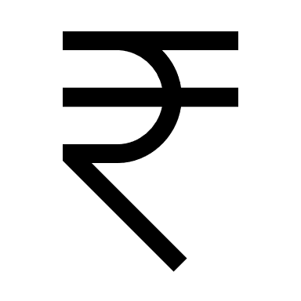
ABOUT
WhatsApp is an American freeware, cross-platform centralized messaging and voice-over-IP(VoIP) service owned by Facebook, Inc.
It is a free messaging app available for Android and other smartphones to send text and voice messages.
Everyone uses WhatsApp to send and receive messages, make voice and video calls, photos, documents, and user locations.
24.27 Bn downloads in India
17.1% (340 Mn) of users from India
Has started payment services WhatsAppPay for easier transactions
PROBLEM STATEMENT
WhatsApp is planning to get into Fin-Tech in India, where they enable their users to buy stocks or mutual funds through its app, naming as WhatsApp Capital, initially starting as stock broking platform like Zerodha, Upstox, ICICI Direct
OBJECTIVE
Goal is to identify the market potential of this idea and build a customer userflow and success metrics to track the progress

Slide 3
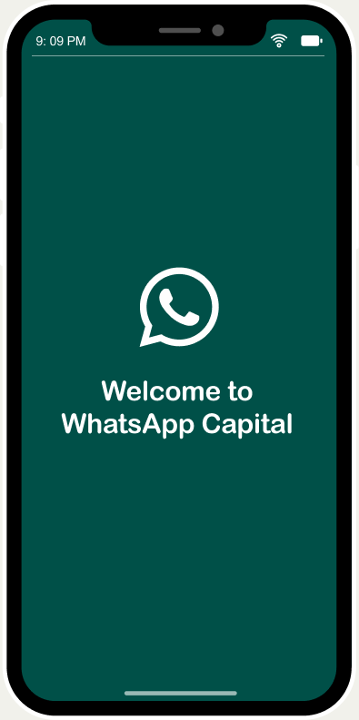
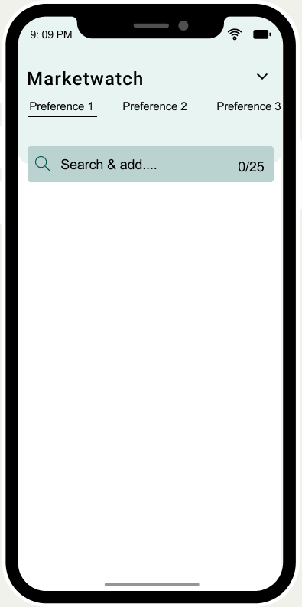
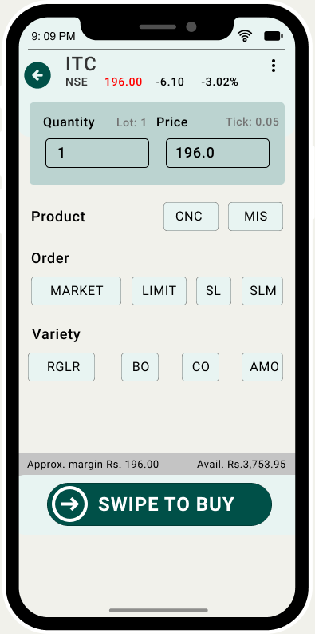




WhatsApp Capital
What?
WhatsApp Capital is a online stock broker where it enables its users to sell or buy stocks, invest in mutual funds, with hassle-free transactions.
Why?
Being one of the most used products in India, it can easily acquire customer for its new services
Due to dramatic increase in online payments, stock exchanges has seen a rapid increase in online trading through stock broking platforms
Since, WhatsApp has already succeeded in enabling payment services through its application, leveraging a stock broking platform would be a new idea to expand its services
COMPETITORS

Slide 4
Revenue Potential = Daily active clients at WhatsApp Capital * Incurred charges * Number of trading days
Daily active clients at WhatsApp Capital :
Targeting a market share of 10% to be in the top 3 in stock broking platforms in India, WhatsApp Capital must have
= 0.10 * 1,34,78,848
= 13,47,885 active clients
Assuming 40% of total clients are daily active clients, then
0.4*13,47,885
= 5,39,154 users are daily active clients
MARKET POTENTIAL
Assuming first brokerage tie up is with NSE
Incurred charges :
To gain a competitive advantage over other companies, let’s charge Rs. 17 at maximum for intraday transactions, options and other
Number of trading days in a year :
At NSE, average number of trading days in a year since 1995-96 is 249 days
Revenue Potential in a year = 5,39,154 * Rs. 17 * 249 days
= Rs. 228.23 crores

Slide 5



USER PERSONAS
Preetham Bashaboina
22 | Student at St. Martin’s college, Hyderabad
Harihar Bolsekar
46 | LIC Agent, Basmat Nagar, MH
Vijaya Alsatwar
38 | English Teacher at Nizamabad, TS
Attends college occasionally, and spents most of the time with his friends
He gets a pocket money of Rs. 5000 per month from his dad
Life insurance agent at his local town Basmat Nagar, Maharashtra
Lives with his wife, and two daughters in a rented house
Teaches English language at Chaitanya High School, Nizamabad
Has two kids, and husband working as a manager at RK Resorts
For family planning, financial security and to manage his expenses, he invests his savings in mutual funds at Aditya Birla, spents some of his time trading at NSE daily
Looking at children’s education and financial security, she and her husband jointly invests their savings in Mutual Funds
To add more money to his wallet, starts investing in stocks, eventually becomes active client at NSE using Upstox platform

Slide 6
USER JOURNEY MAP FOR BUYING OR SELLING STOCK
Downloads WhatsApp Cap. App
Opens App
Account created?
No?
Opens DEMAT Account
Enters login credentials
No Funds in wallet
Add Funds
Buy?
Sell?
Any stocks to be observed frequently
Taps on search bar
Navigates to Portfolio
Searches for the required stock
Adds to his/her preferences
Searches or selects shares of his preference
Selects the stock
Search more?
Not interested?
Taps Exit
Clicks on Buy Option
Confirms the options and select his preferences
Selects the quantity of shares, options & his/her preferences
Clicks on ‘Swipe to Buy’
Clicks ‘Swipe to sell’
Completes buying/ selling a stock

Slide 7
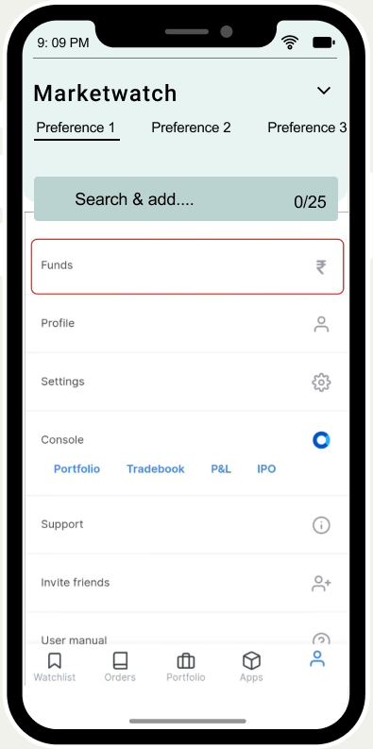
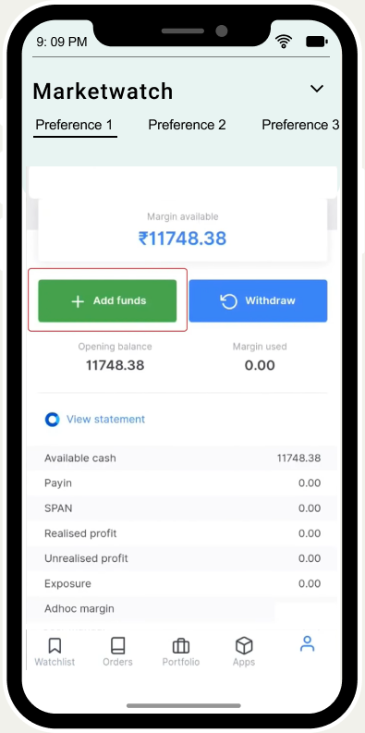
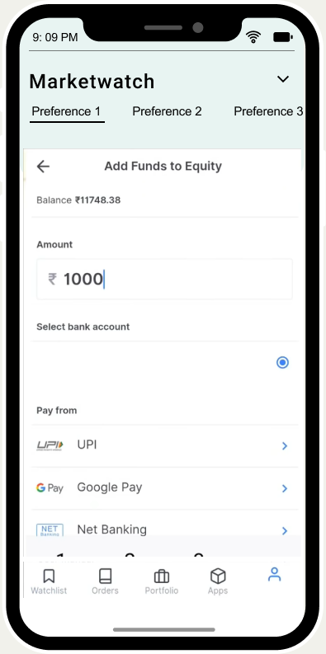
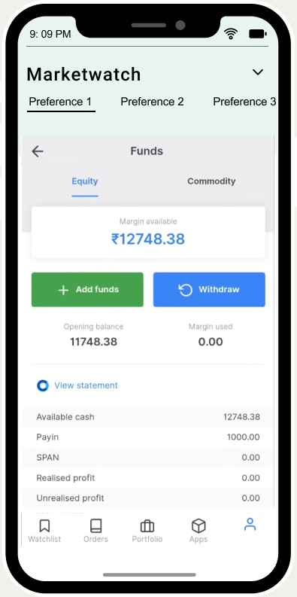
ADDING FUNDS TO WALLET

Slide 8
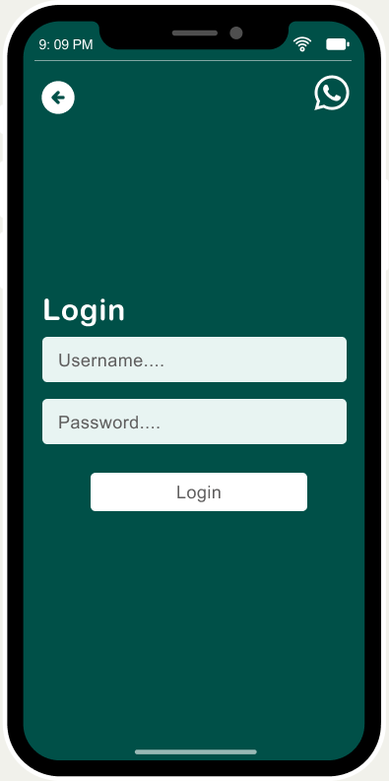
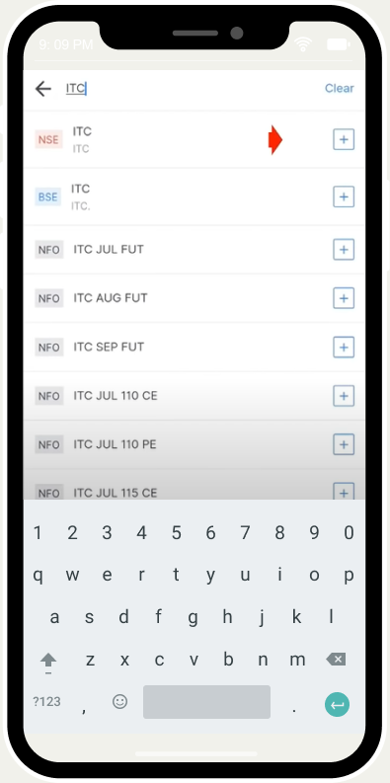
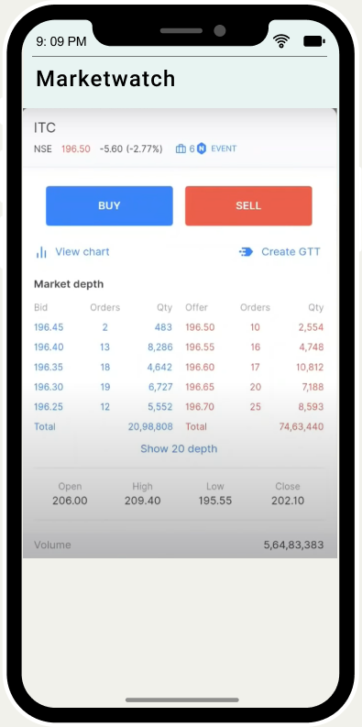
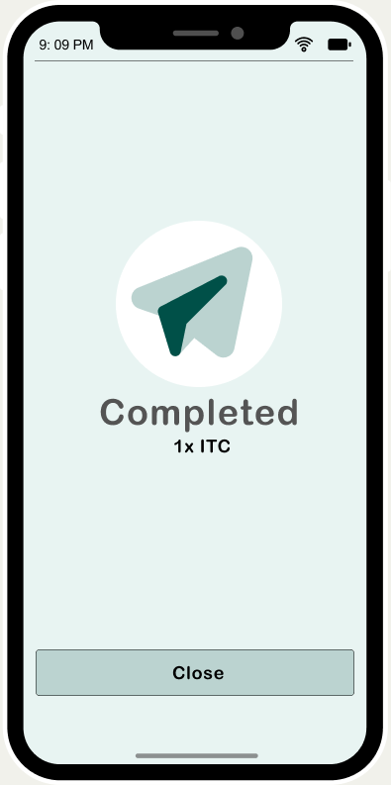
BUYING A STOCK

Slide 9
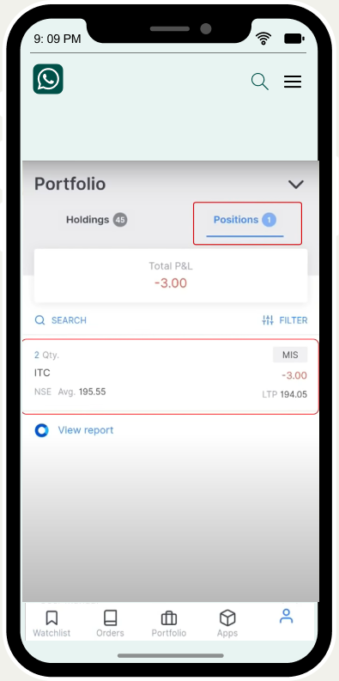
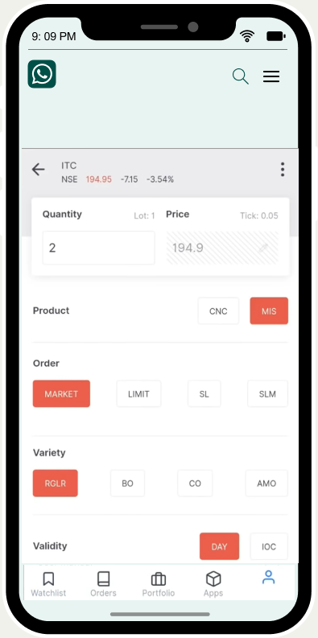

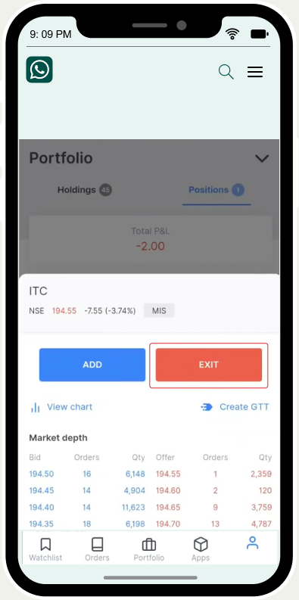
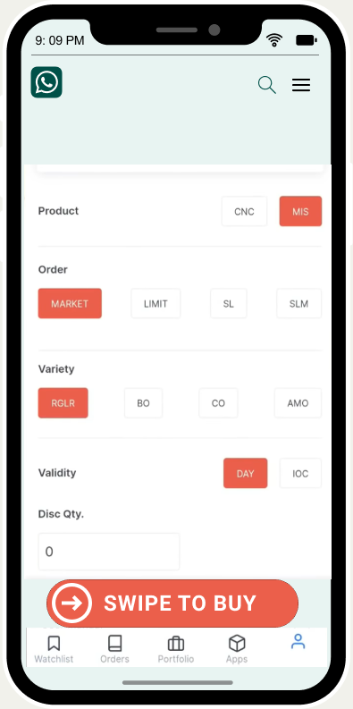
SELLING A STOCK

Slide 10
USER JOURNEY MAP FOR BUYING OR SELLING A MUTUAL FUND
Downloads WhatsApp Cap. App
Opens App
Account created?
No?
Opens DEMAT Account
Enters login credentials
No Funds in wallet
Add Funds
Taps button on top left corner of the app
Selects ‘Mutual Funds’
Navigates to portfolio
Taps on ‘Sell Fund’
Taps on search bar
Enters number of units
Selects the fund
Confirms the selling
Looks at the performance of the fund
Completes Buying/ Selling a mutual fund
Selects method of investment
Taps on ‘Buy Fund’
User selects the amount to be invested looking at the minimum investment required
Confirm the buying

Slide 11
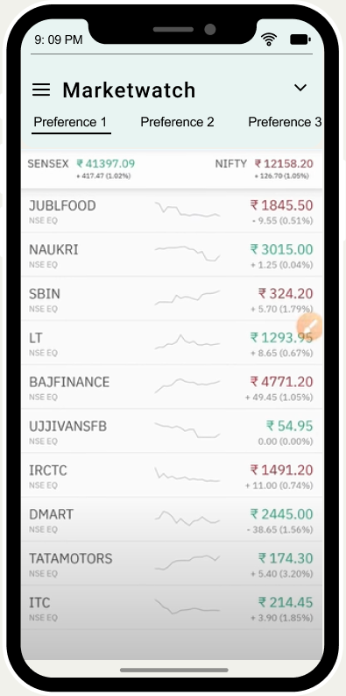
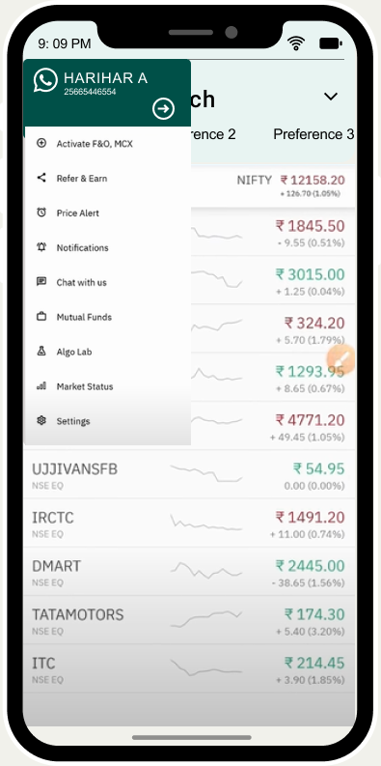
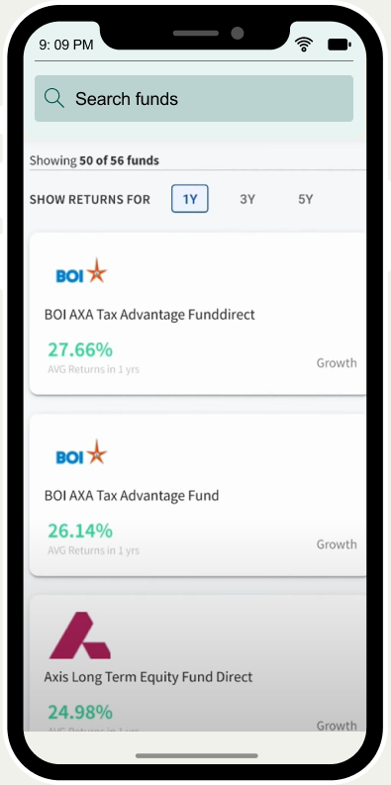
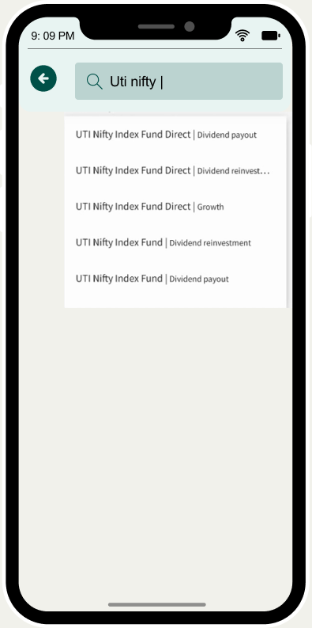
BUYING A MUTUAL FUND

Slide 12
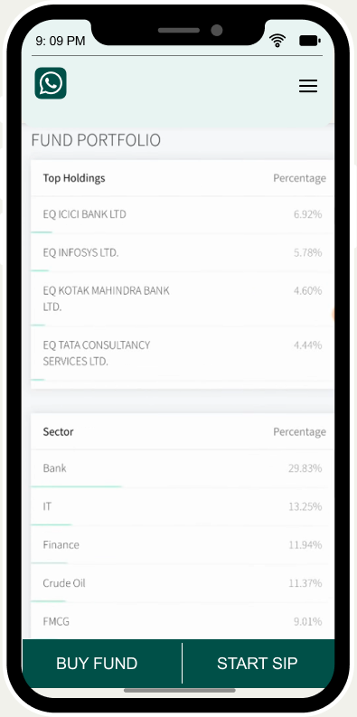
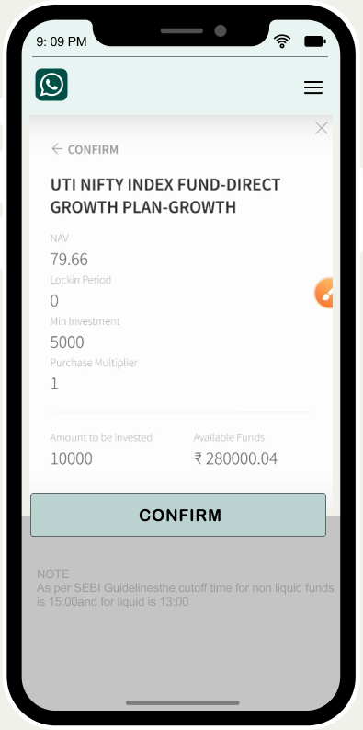
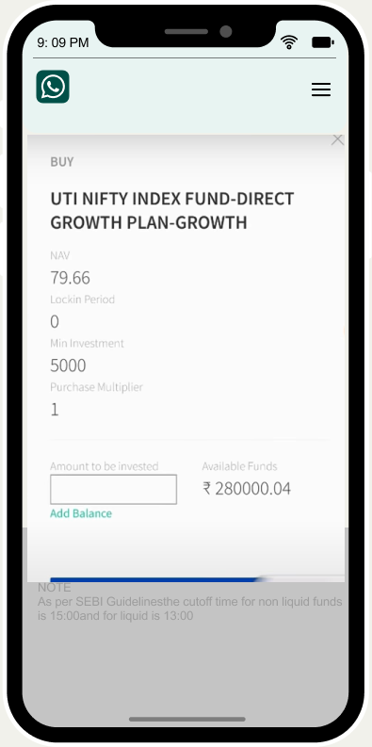
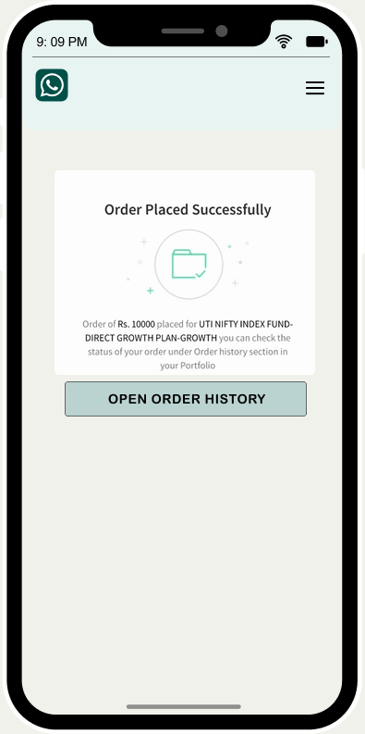
BUYING A MUTUAL FUND

Slide 13
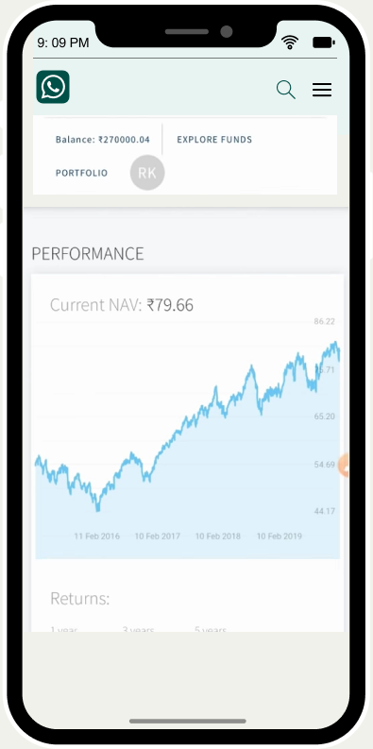
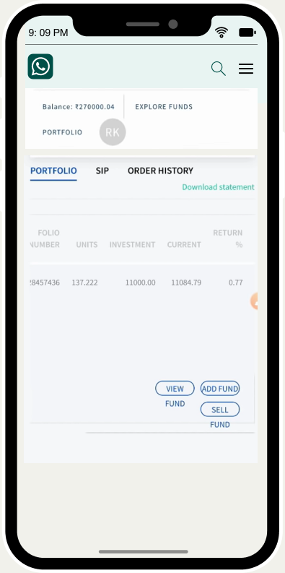
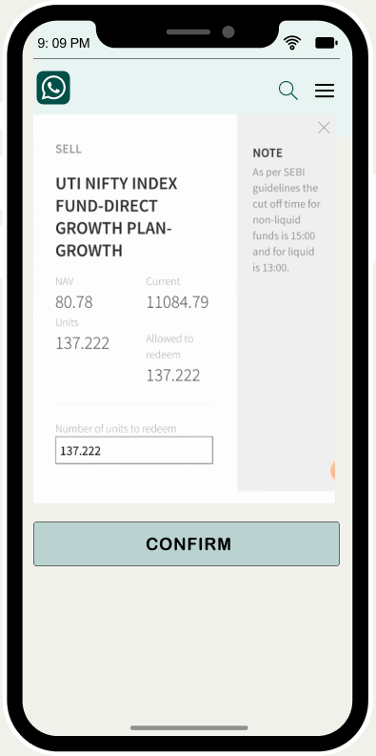
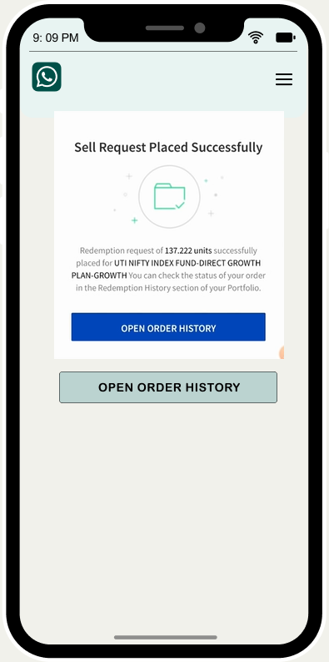
SELLING A MUTUAL FUND

Slide 14
SUCCESS METRICS
Acquisition
Activation
Engagement
Retention
Number of demat accounts created through WhatsApp Capital
Number of logins where demat accounts were not created through WhatsApp Capital
Number of first time traders on WhatsApp Capital
Number of daily active traders
Average number of trades per users
Number of intra day trades
Number of trades per month/ per year
Trading turnover daily/monthly/yearly
Net profit generated
Number of 7-day or 30-day intraday traders
Ratio of Daily active clients and Monthly active clients

Slide 15

PRESS RELEASE :
WhatsApp unlocks itself by enabling users buying stocks and investing in mutual funds in India(2021)
Highlights :
Stocks or shares buying and selling, selling and buying mutual funds is available to all users in India;
WhatsApp Capital App begins testing its services with over 1 million users in early quarter of 2021
WhatsApp Capital feature is rolled out for android and iOS
Whatsapp Capital got a green signal from the National Stock Exchange(NSE) and Bombay Stock Exchange(BSE) to launch a online stock broking platform on a wide network in India.
Whatsapp Capital is approved to buy shares, sell shares at NSE or BSE by users across India, Now you can easily buy or sell your shares without navigating into other app. With minimal fee of Rs. 17, WhatsApp Capital charges for intrdaday trading , orders and other transactions. Whatsapp Capital is completely secured and private too.
India’s stock brokers market is presently crowded by some domestic Competitors like Zerodha, ICICI Direct, Upstox, Angel Broking Etc. WhatsApp has more than 400 million users in India and Will easily acquire the users Organically for its stock broking system on its platform. Whatsapp also tweeted early today that “Starting today, people across India will be able to buy shares through WhatsApp”

Slide 16
Thank you!
Alsatwar Sravan Kumar
Pre-final year student, IIT(ISM) Dhanbad
alsatwarsravan@gmail.com

